Slide 1


Slide 2
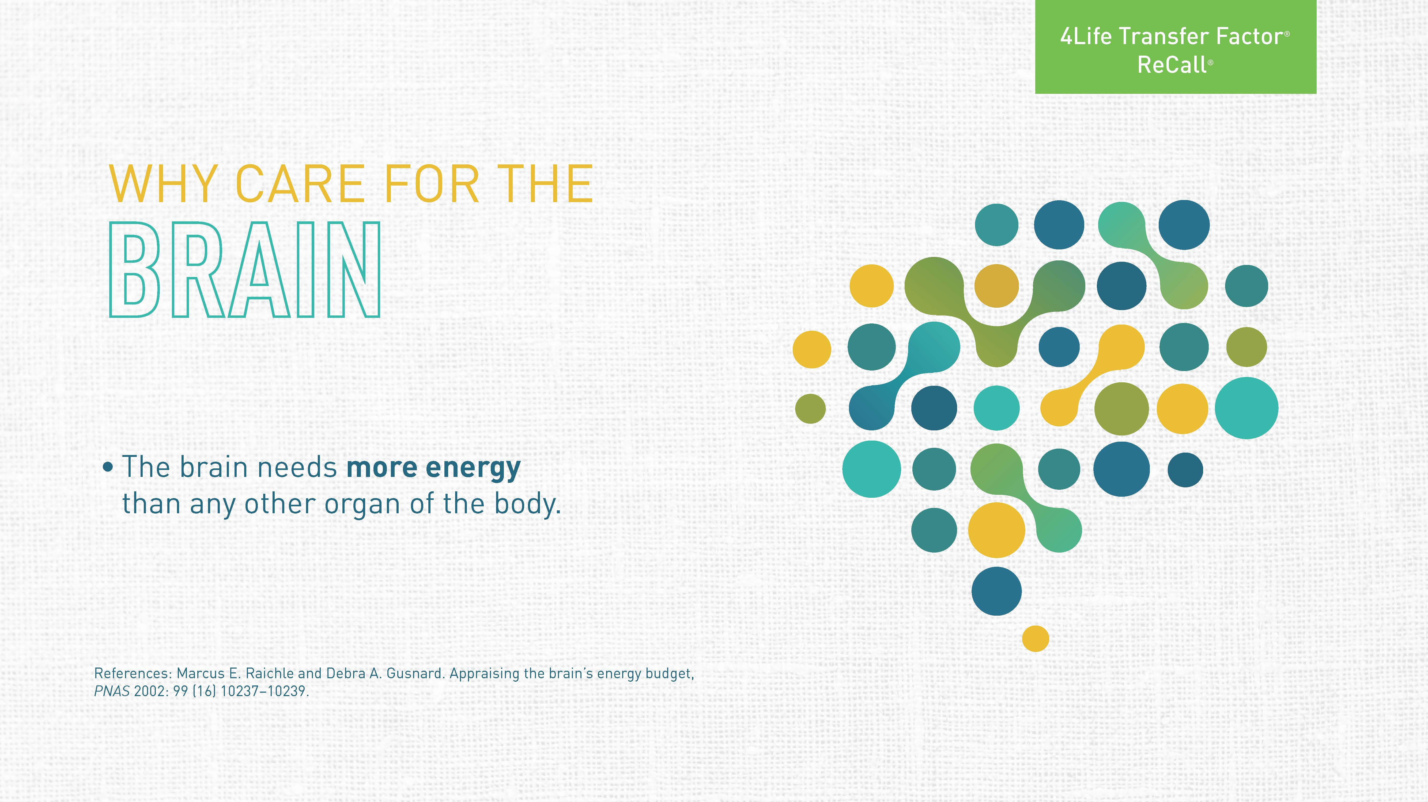
Notes:
At least 20% of the total calories you consume go to the brain. This indicates that the brain needs a lot of care. Part of its high-energy requirement is the quick firing of neurons, and the other is the constant reactions that take place. In other words, the brain is a highly active organ.

Slide 3
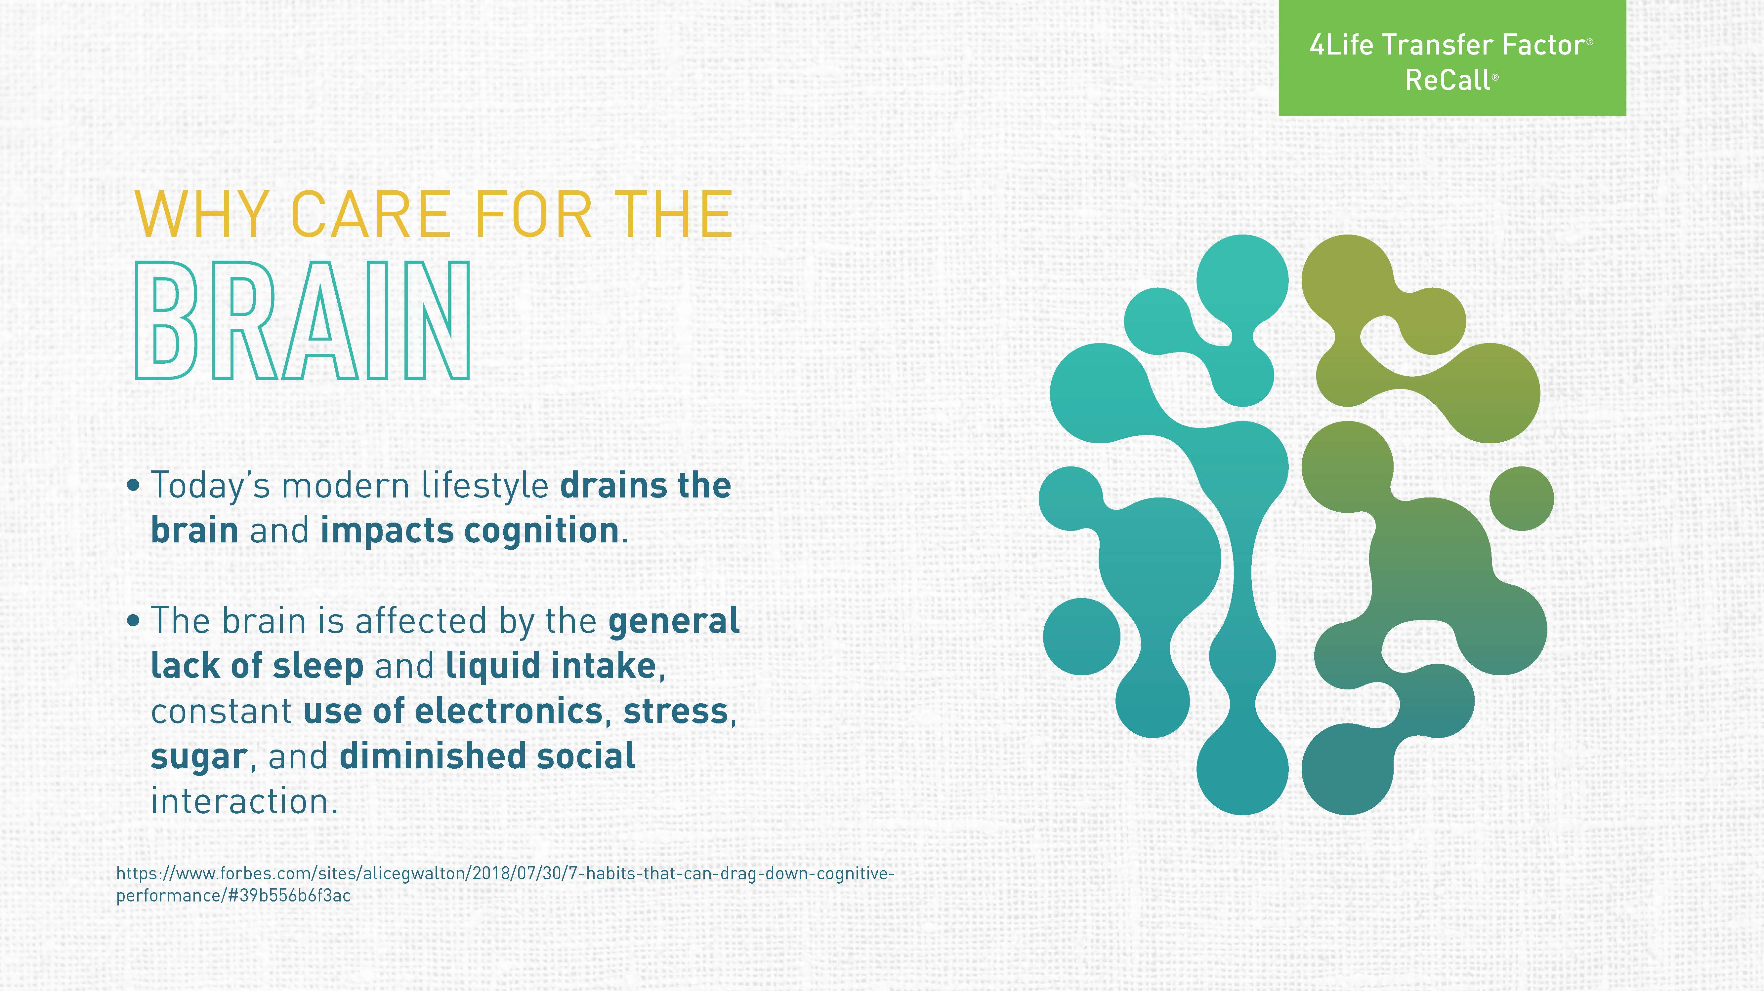
Notes:
Today’s modern lifestyle doesn’t help. Several factors contribute to drain the brain’s energy. Lack of sleep or diminished sleep quality affect the constant reactions that maintain a healthy brain. These behaviors ultimately affect your cognitive process, or the thinking process and memory.

Slide 4
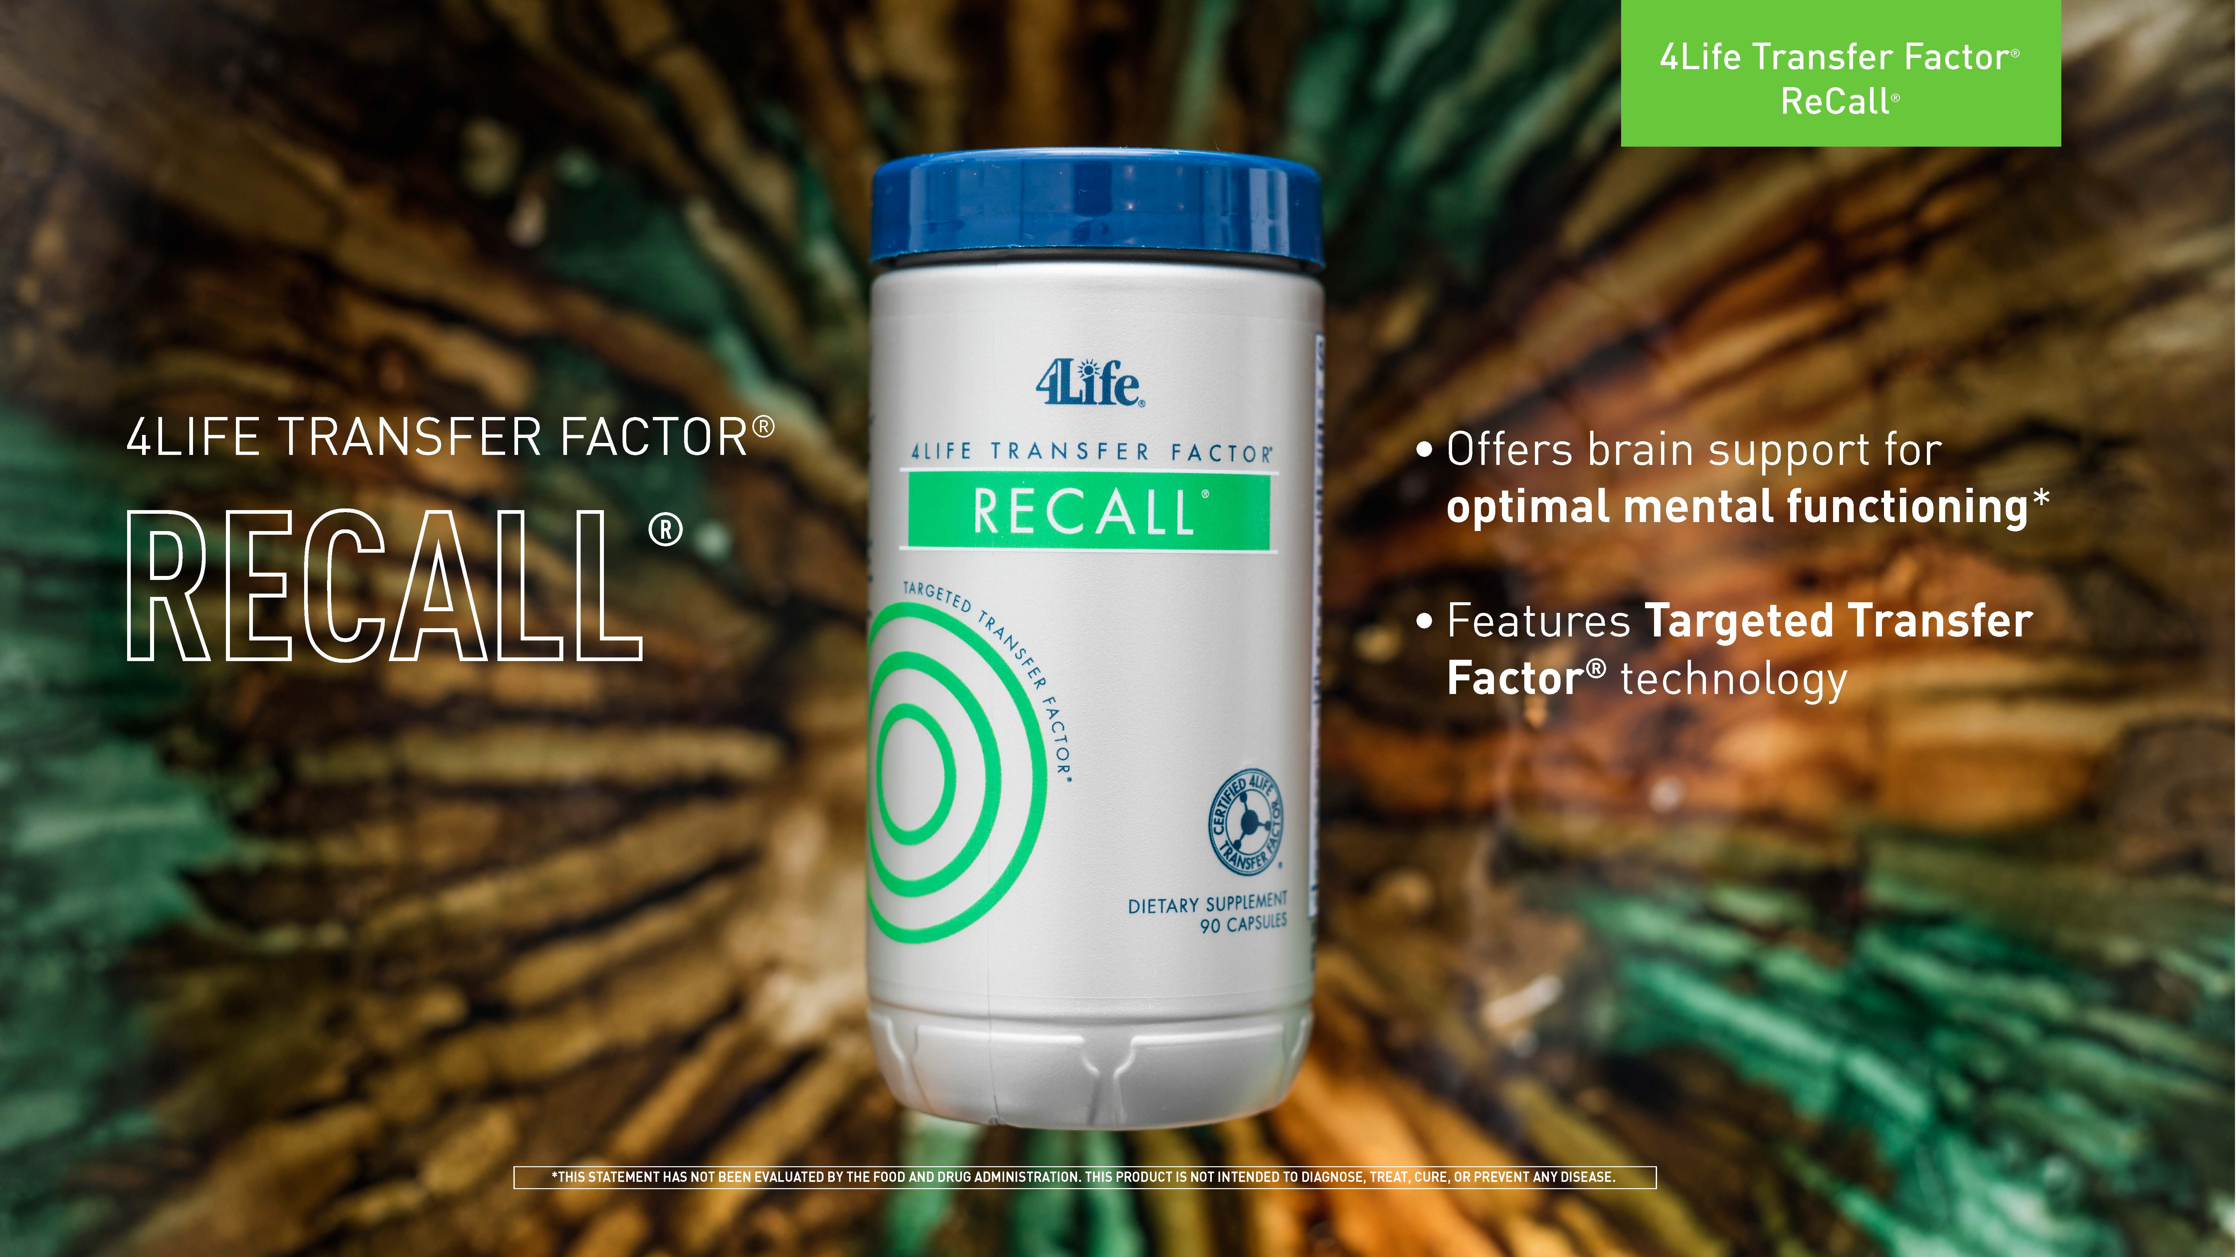
Notes:
4Life Transfer Factor ReCall was formulated to support the needs of the adult brain. It delivers ingredients that are important for the structure of the brain and mental functioning. And since the immune system is affected by the aging process, ReCall provides the power of 4Life Transfer Factor®.*

Slide 5
Notes:
Blood flow is important to the brain. As you, age blood flow tends to get less efficient because of the brain’s high-energy demand. It’s important to improve blood flow. Neurotransmitters are another important aspect of mental functioning, particularly acetylcholine. Oxidative stress is another important focus for the brain. The brain’s high activity produces oxidative stress. Let’s look at the ingredient profile to understand how 4Life Transfer Factor ReCall targets each of these areas.

Slide 6
Notes:
This product includes 4Life’s proprietary formulation of transfer factors from cow colostrum and chicken egg yolk to support the immune system.*

Slide 7
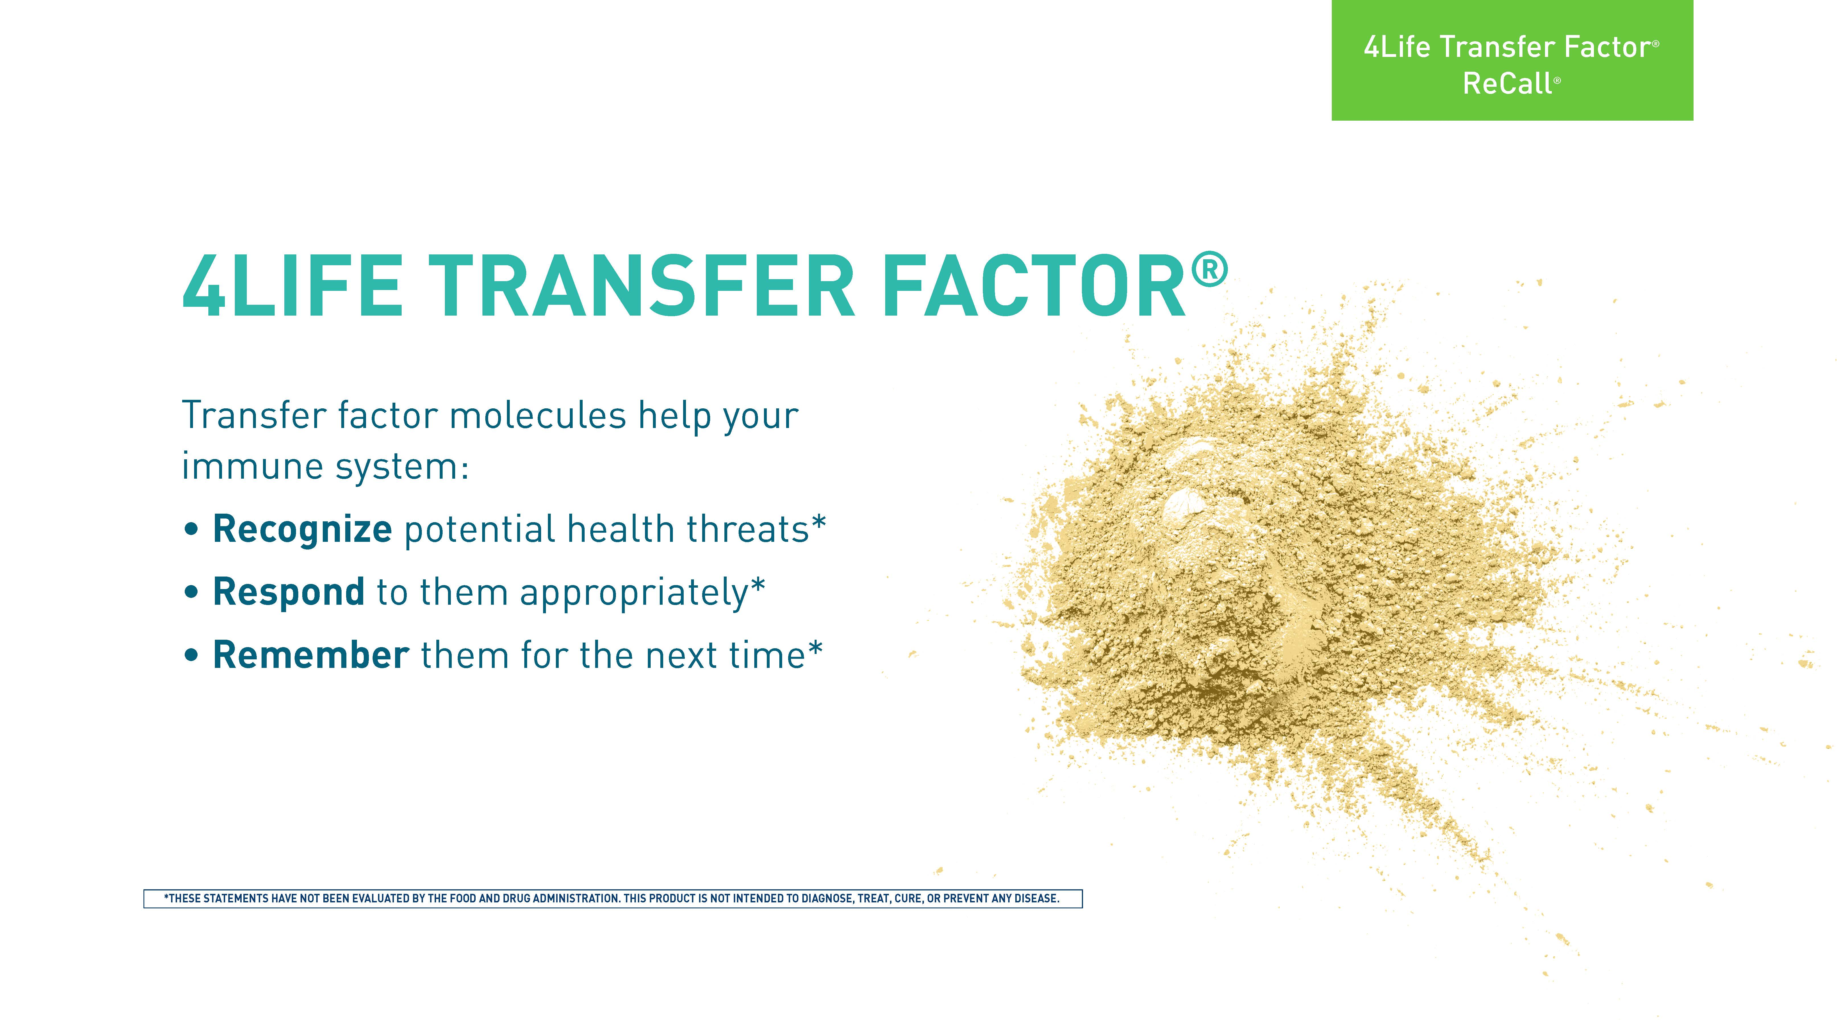

Slide 8
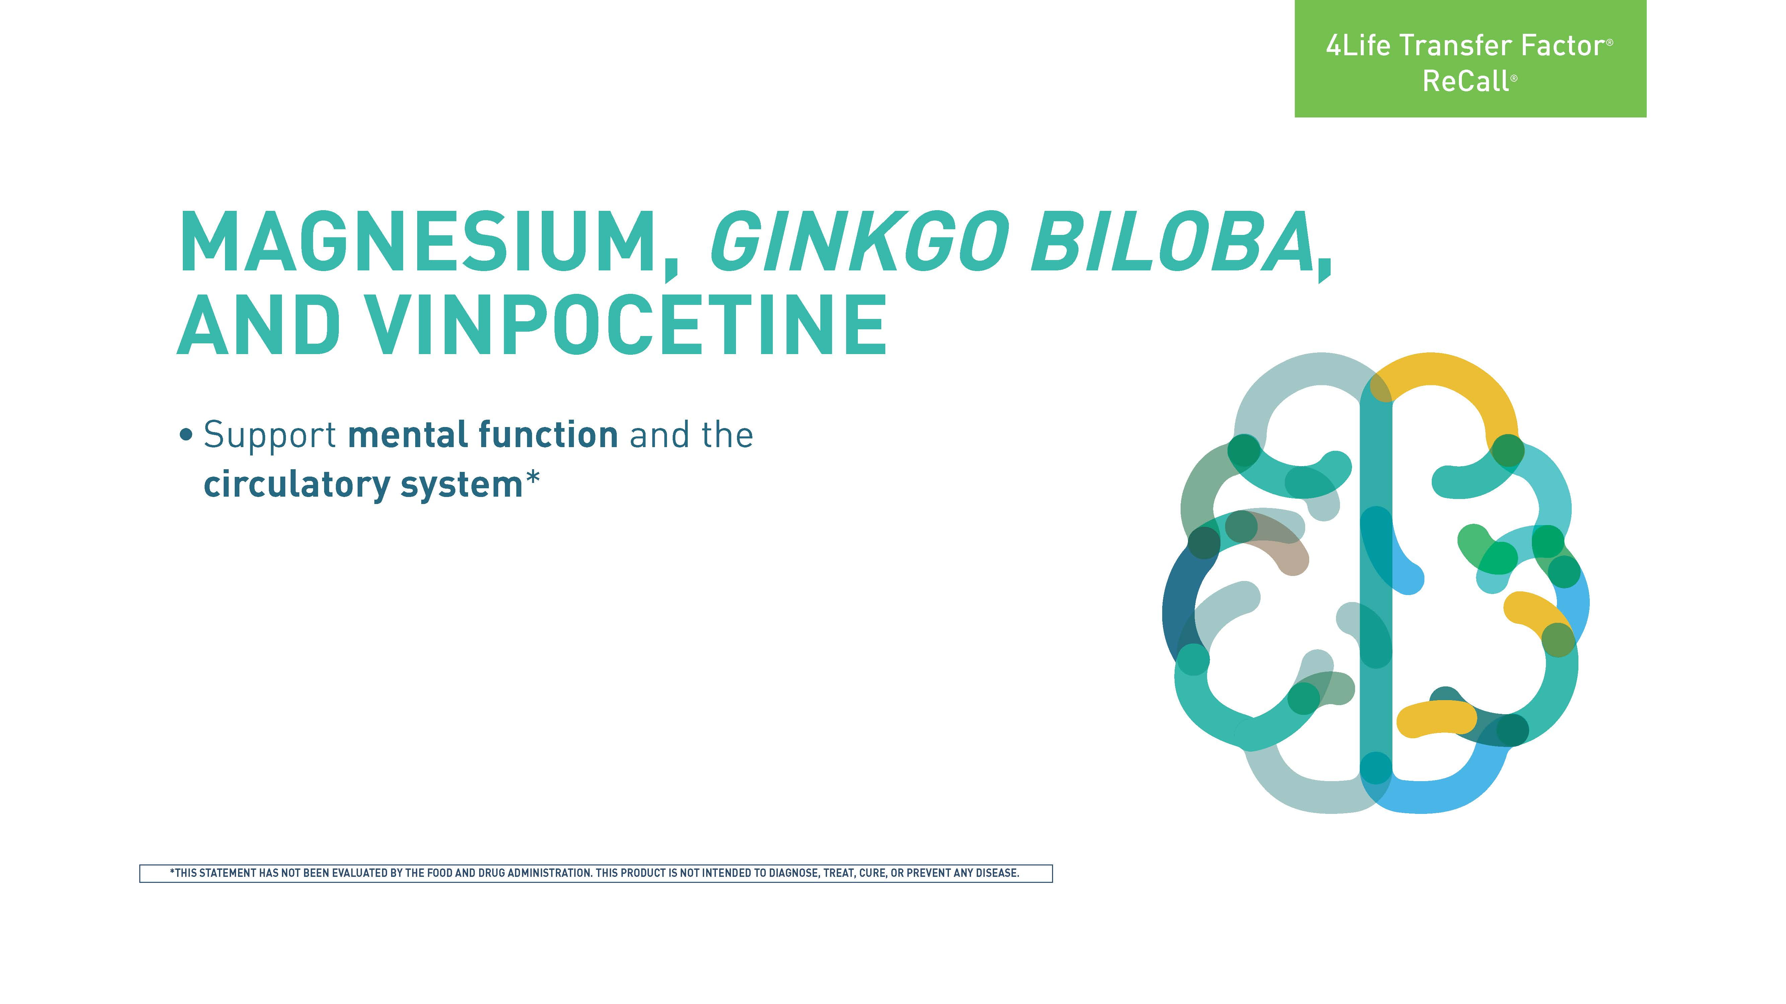
Notes:
A mineral abundantly present in the body, especially in the bones, magnesium participates in hundreds of enzymatic reactions. Magnesium has shown benefits for mental functioning, probably due to its vasodilatory effects, which improves cerebral blood flow. Ginkgo biloba and vinpocetine are known for their cognitive effects. Although other mechanisms might be involved, improvement of cerebral blood flow is one way by which these ingredients improve mental function.*

Slide 9
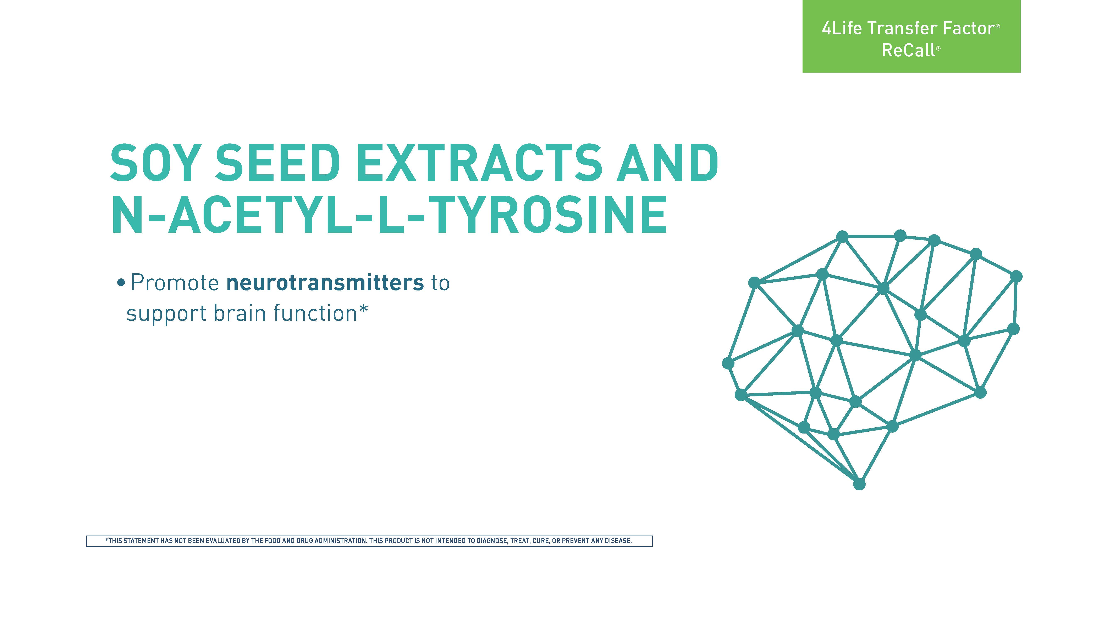
Notes:
Soy seed extract is a source of phosphatidylserine and glycerophosphorylcholine (GPC). These phospholipids are nutrients involved in the production of acetylcholine, the major neurotransmitter that mediates mental function. These phospholipids are also part of the membrane of brain cells that serve as structural and signaling molecules. Tyrosine is the precursor of the neurotransmitters dopamine and norepinephrine, which are also involved in healthy mental function. Because tyrosine by itself has poor solubility, N-acetyl-L-tyrosine was used to increase the level of these neurotransmitters.*

Slide 10
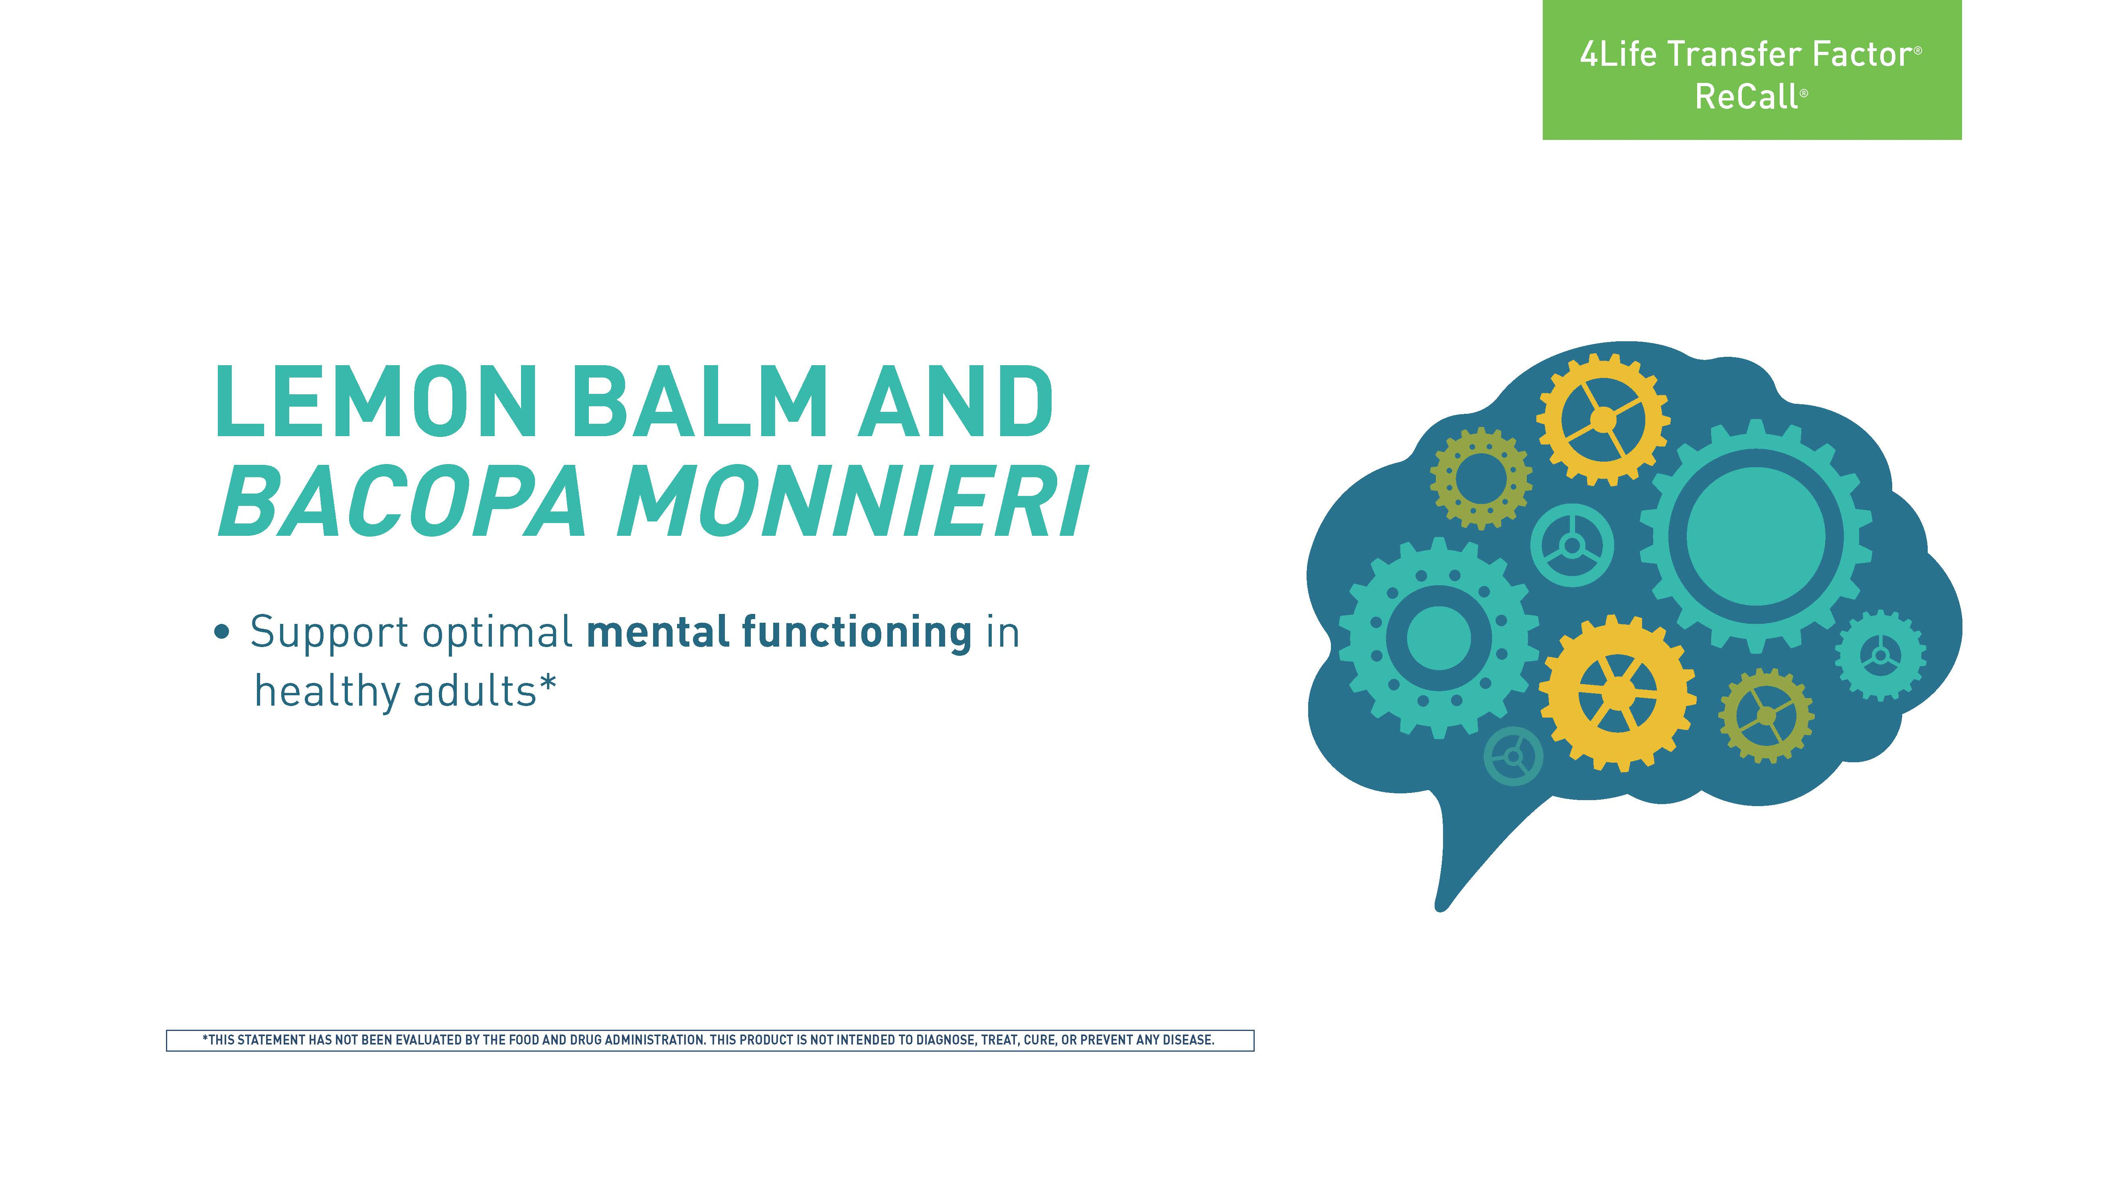
Notes:
These two herbs are used for brain support. They improve mental functioning, likely through activation of multiple neurotransmitters.*

Slide 11
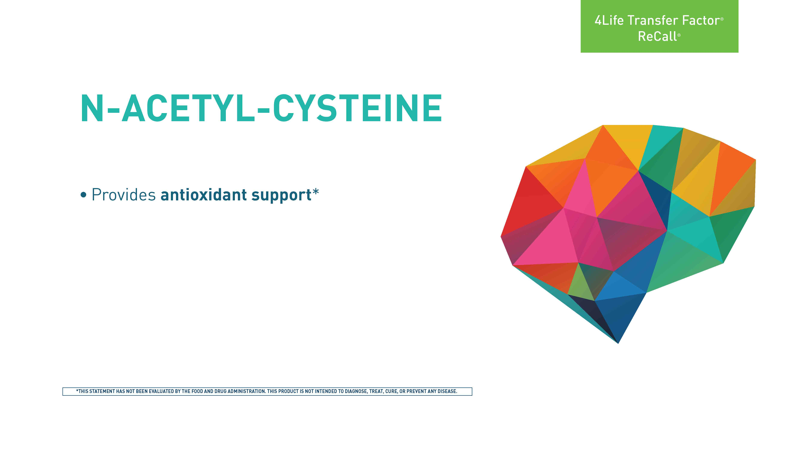
Notes:
N-acetyl-cysteine is the precursor of cysteine, which is the precursor of glutathione. Glutathione is an endogenous antioxidant molecule that reduces oxidative stress in the body. *

Slide 12
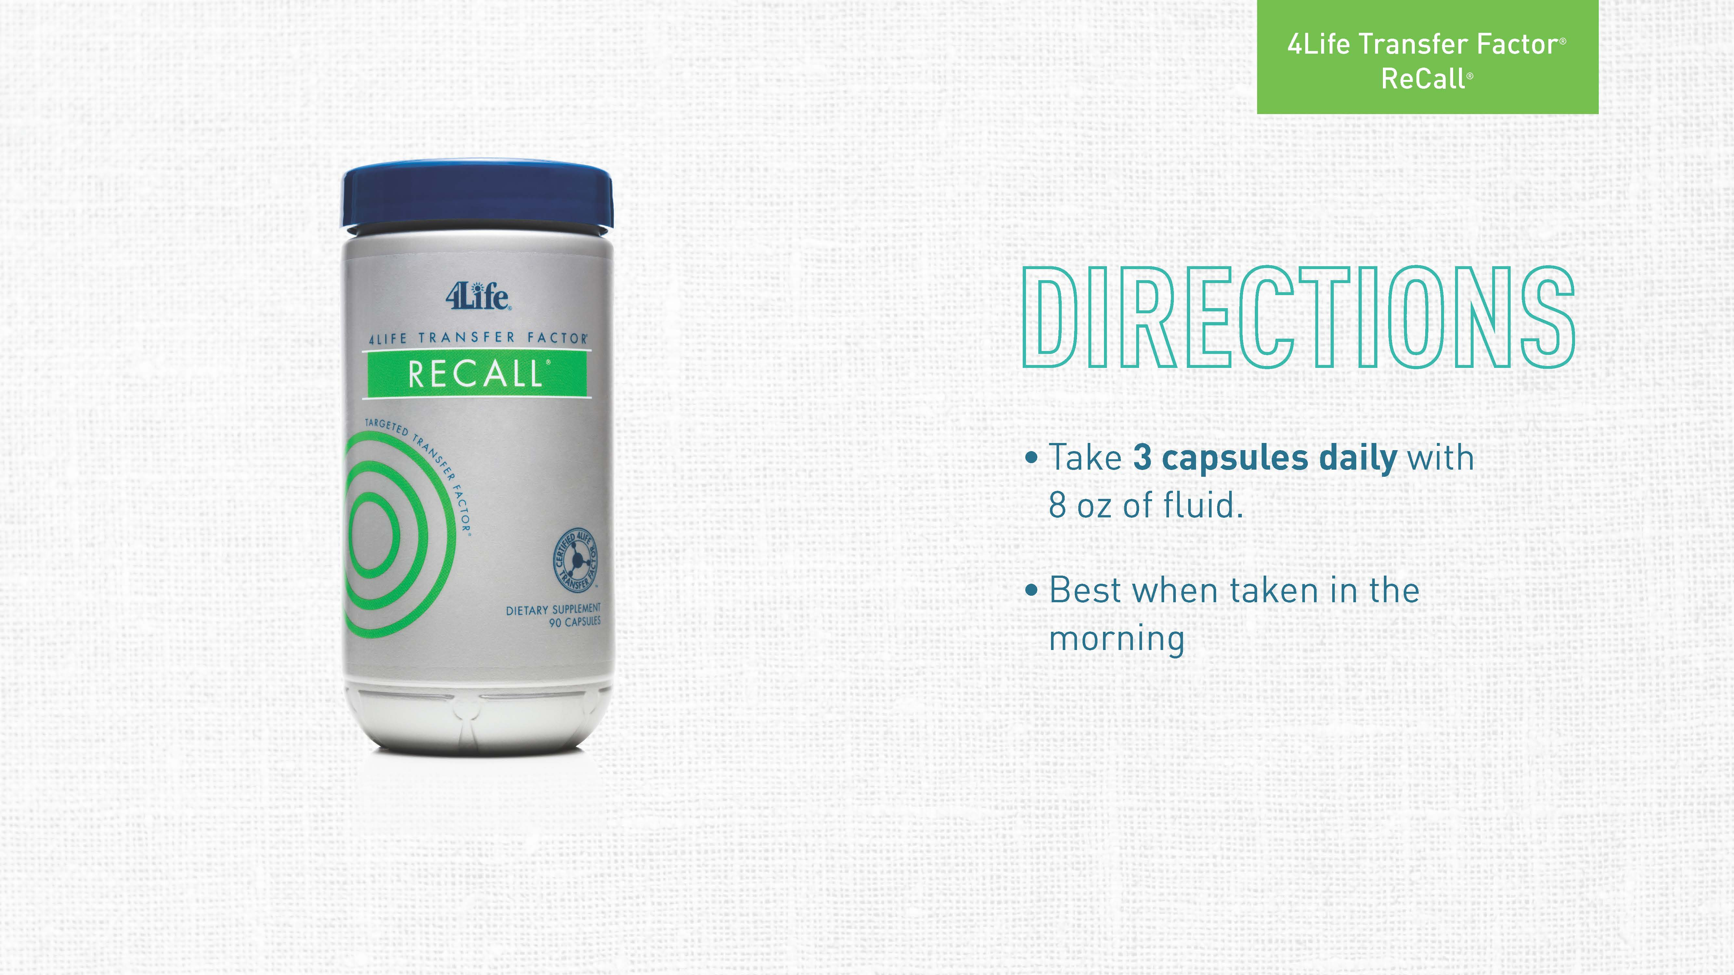
Notes:
Take 3 capsules daily with 8 oz of fluid. It is best to take ReCall® in the morning so as not to combine with brain supplements intended to support sleep that are taken in the afternoon or evening.

Slide 13


